Slide 1

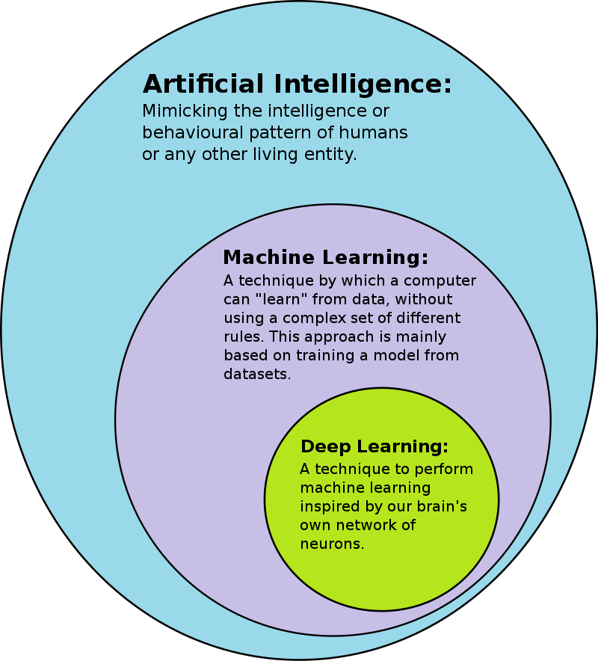

CSC485B Machine Learning for Robotics
SUNY Plattsburgh
Dr. Ned Lecky
Class 22: Deep Learning- What’s It All About?

Slide 2
Deep Learning
Many layer NNs
Somewhat abandoned in the 1990s and 2000s
Advancements
Better activation functions
More powerful adjustment between layers
GPU hardware to accelerate training

Slide 3
What Does it Look Like??
Todays material is all from Ch 11 Géron…
What’s selu, lecon_normal, softmax???
These are the things that can make DL work! Let’s explore.
model = tf.keras.Sequential()
model.add(tf.keras.layers.Flatten(input_shape=[28, 28]))
for layer in range(100):
model.add(tf.keras.layers.Dense(100, activation="selu",
kernel_initializer="lecun_normal"))
model.add(tf.keras.layers.Dense(10, activation="softmax"))

Slide 4
Problems with DL
Vanishing Gradients / Exploding Gradients
Training data volume may need to be large
Training time… may be VERY slow
Although execution time (forward) is usually quite fast
Risk of severe overfitting

Slide 5
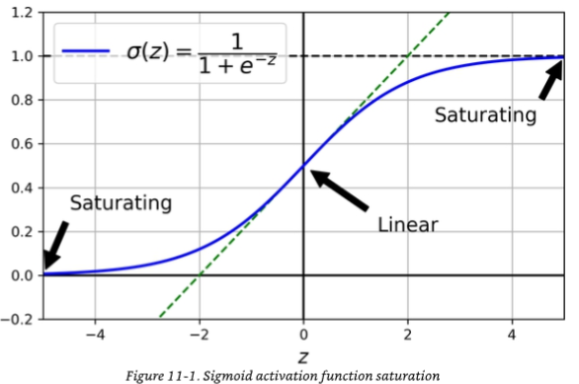
Sigmoid Function Saturation
Once the outputs saturate, we have no way of mathematically adjusting the weights connected to it in any sensible way

Slide 6
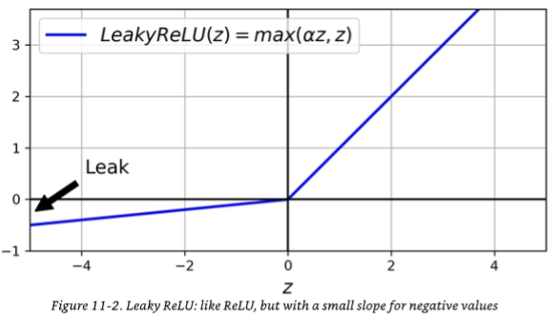
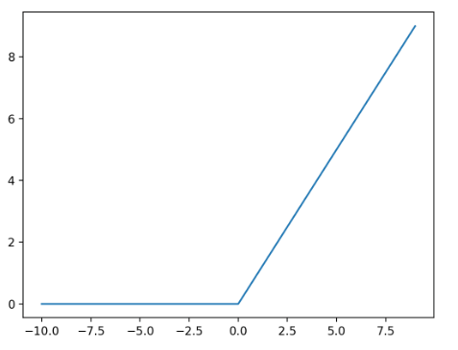
Better Activation Functions
The core NN activation function is ReLU (Rectified Linear Unit)
Sigmoid looks better
But it is much slower to computer
LeakyReLU(z) = max(az, z)
Still fast to compute
Always has a non-zero slope

Slide 7

Still Mathematically Challenged
Discontinuous at z=0 means jittery adjustments to weights near there
Also, highly susceptible to behaving quite differently depending on what you set the initial (random?) weights to!

Slide 8
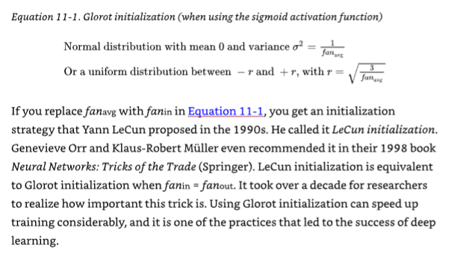
Glorot Initialization
Don’t have the signals explode or die out
Have variance of outputs of each layer to be similar to variance of inputs
Fan-in = in number of inputs to a layer
Fan-out = is number of outputs

Slide 9
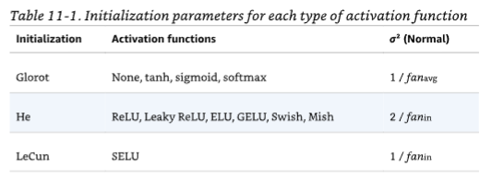
Some Battle-Tested Initializations
Set initial weights to get the variance of the outputs similar to the variance of the inputs in some way

Slide 10
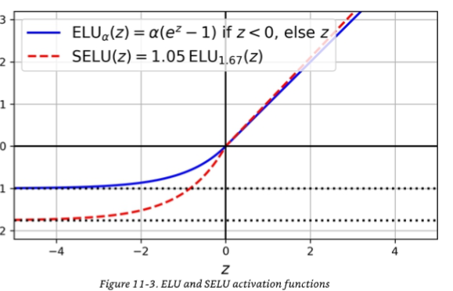
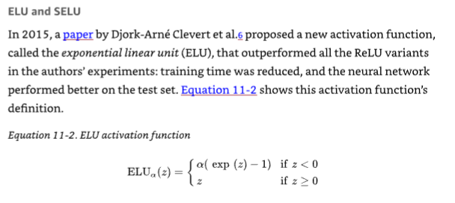
ELU and SEMU
Exponential Linear Unit- introduced in 2015
2017 improvement: Scaled ELU
The math shows that a NN with all SELU activation will self-normalize
Output of each layer will tend to a mean of 0 and a stddev of 1 during training

Slide 11
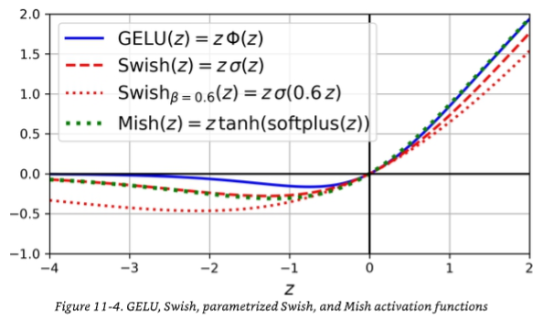
More Activations
Developed in the 205-2019 timeframe
Which to use
DOTA
ReLU is a safe (fast) first bet
Swish and Mish are probably the best
LeakyReLU is a faster compromise between ReLU and Swish

Slide 12
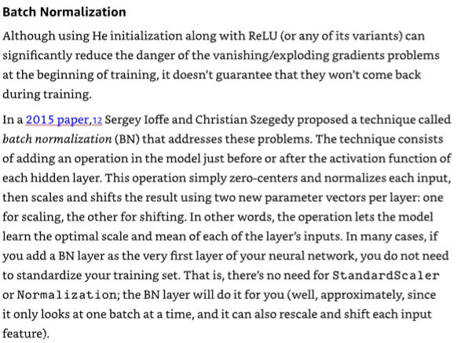
Batch Normalization
He initialization gets your output variance looking like your input variance at the start
Everything can still go off the rails during training!!!
The math is a bit wonky since the layer needs to work forward AND backward for training

Slide 13
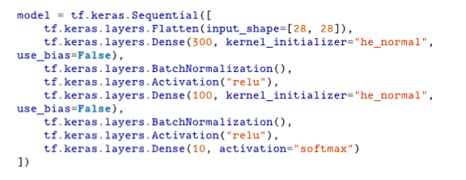
So, in Keras…
Make sense?
Wait- what’s softmax?
https://en.wikipedia.org/wiki/Softmax_function
Another trick… gradient clipping
Just limit the gradients to some max/min value during training

Slide 14
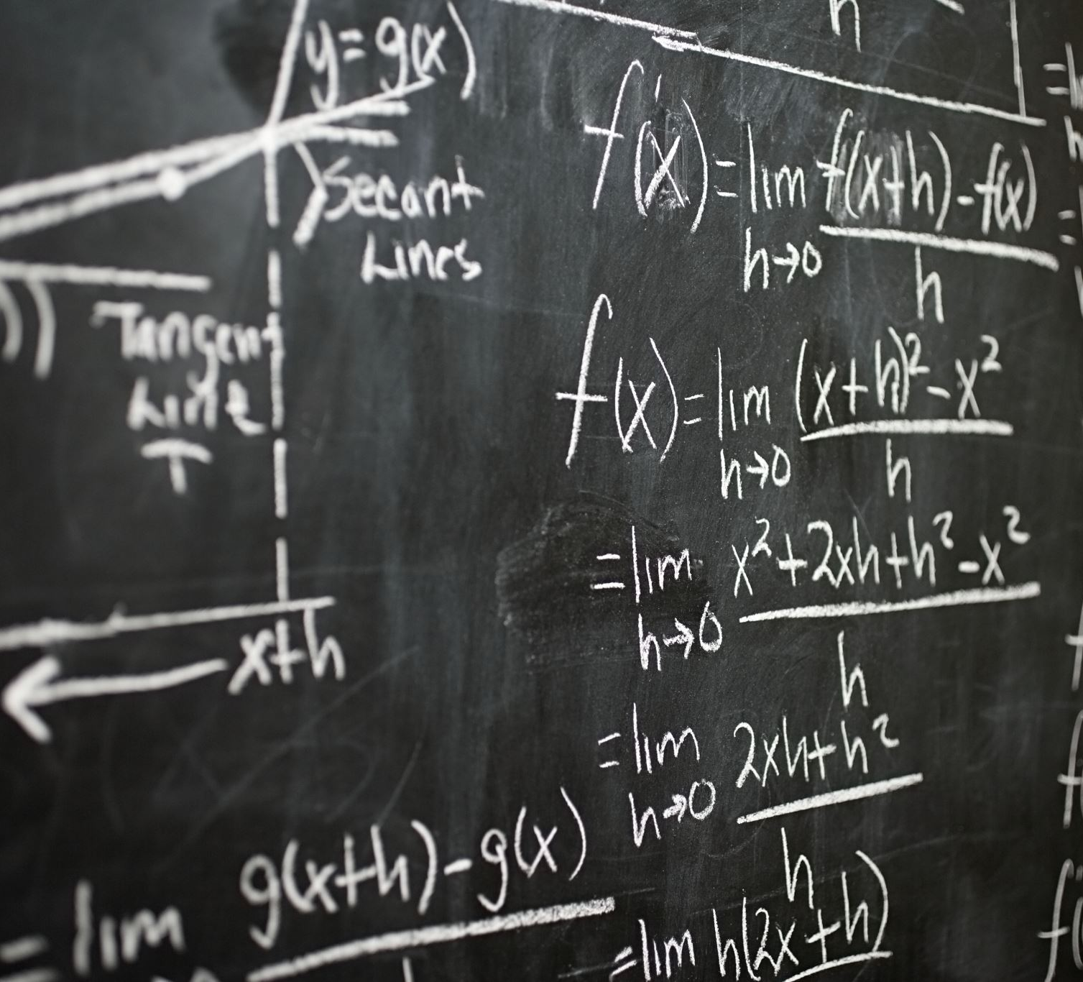
OK, So Where Are We?
Deep Learning
Lots of layers
Needs better activation functions (LeakyReLU, Mish, Swish, …)
Needs better initialization (He, …)
Batch Normalization (Rescaling layers) a good idea
Easy to do all of these in Keras or PyTorch
Run through Géron’s Chapter 11 sample code…
https://colab.research.google.com/github/ageron/handson-ml3/blob/main/11_training_deep_neural_networks.ipynb

Slide 15
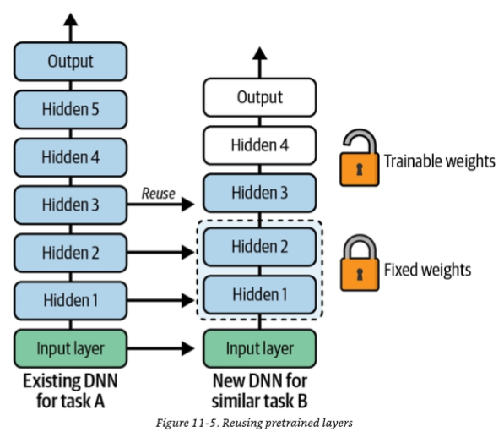


Reusing Pretrained Layers
AKA Transfer Learning
Training a huge NN from scratch might be very slow
Try to start with something similar and reuse some of the layers!

Slide 16
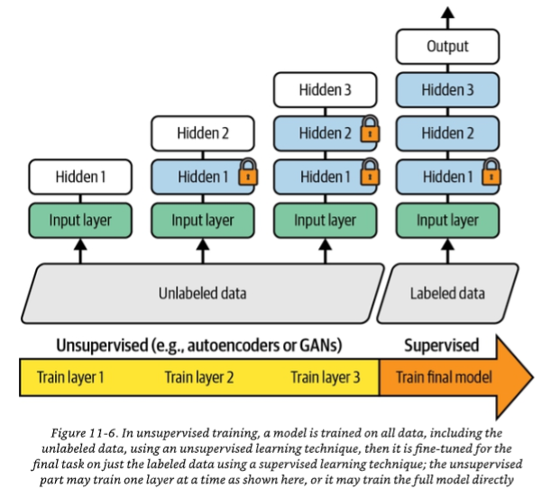
Unsupervised Pretraining
Often very helpful…

Slide 17
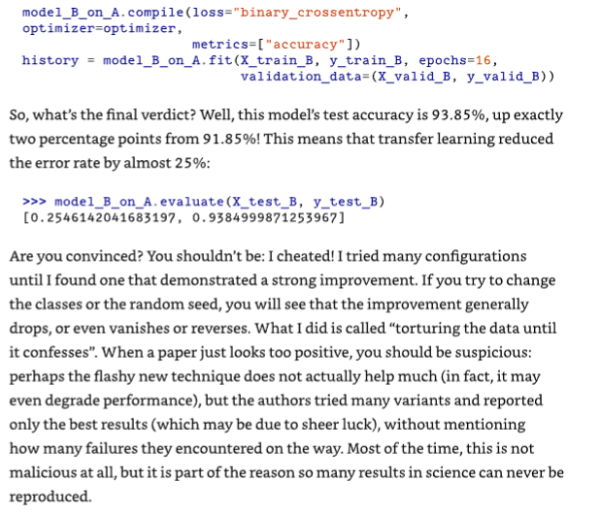
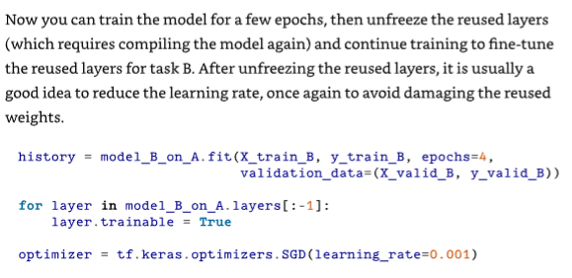
Buyer Beware

Slide 18
Optimizers
Four ways to speed things up
Better weight initialization strategy
Better activation functions
Batch Normalization (Weight Renormalization)
Reuse pretrained network
Another big potential win- the optimizer (weight adjuster)
Traditional gradient descent
Momentum
Nesterov accelerated gradient
AdaGrad
RMSProp
Adam and friends

Slide 19
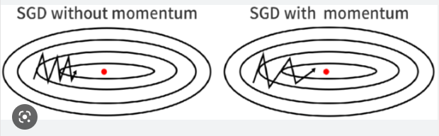
Momentum
The weight adjustments pick up speed and can also roll over the hill to get to better minima
In use since 1960

Slide 20
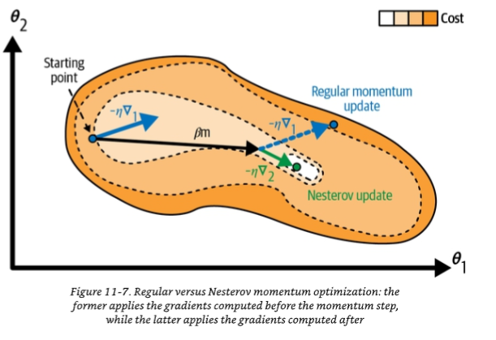

Nesterov Accelerated Gradient
NAG
Better than pure momentum
Yurii Nesterov, 1983
Really, just look ahead a bit to measure your gradient
Very simple fix that rarely hurts!

Slide 21
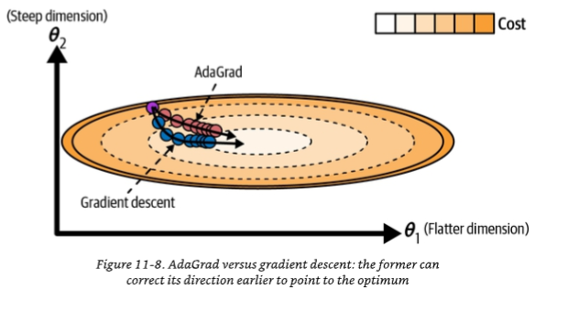
AdaGrad
Adaptive Gradient Descent
Tunes and adapts the learning rate based on steepness of descent
Big advantage: setting the learning rate “exactly right” is less important!
Drawback: in deep networks, it can turn the learning rate down too much which slows the training more than we can tolerate

Slide 22

RMSProp
Fixes the “conservative” slowdown of AdaGrad
Only looks at the last few gradients and this can keep the training rate higher as you approach the end of training
Almost always the best of all (until Adam came around!)

Slide 23
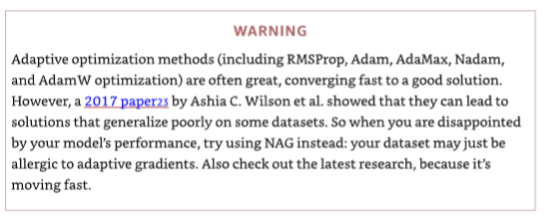

Adam and Offspring
Adaptive Moment Estimation
Combines momentum and RMSProp
Variants
AdaMax: Adam with some stabilization
Nadam: Adam plus Nesterov (NAG)
AdamW: Adam with weight decay

Slide 24
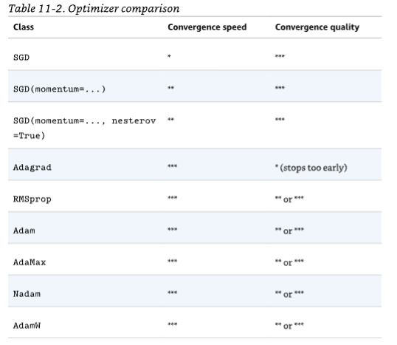
Summary / Opinion / Swag
At the end of the day, these are all HEURISTICS
No one can be stated as the best approach for any particular problem
Re-randomize your weights and success can turn into failure
You might want to just design your own for some particular commercial problem

Slide 25
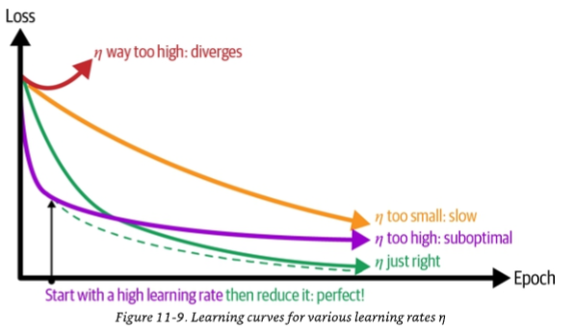
Learning Rate Scheduling
A major improvement over “dumb” adaptive learning rate: schedule it ourselves!
Many things to try
Power Scheduling
Lower with epoch
Exponential Scheduling
Raise with epoch
Piecewise Constant Scheduling
Choose various values based on epoch ranges
Performance Scheduling
Try to compute a better training rate based on how the losses are evolving
1cycle Scheduling- 2018
Almost like a triangle wave!

Slide 26
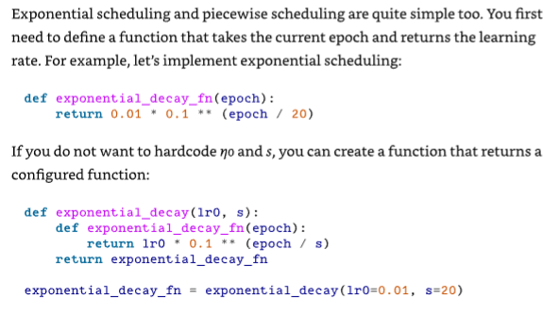
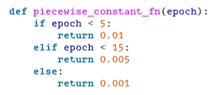


How to do it?
May be built-in to your optimizer (decay)
Or you can build a function and pass it into the optimizer
Keras flavors shown

Slide 27

Regularization
A large number of techniques designed to keep weights from getting overfit or unruly
Early Stopping (don’t overtrain)
Batch Normalization- this is a type of regularizer as well as a training helper
L1 and L2 regularizers
Next slide: Dropout

Slide 28
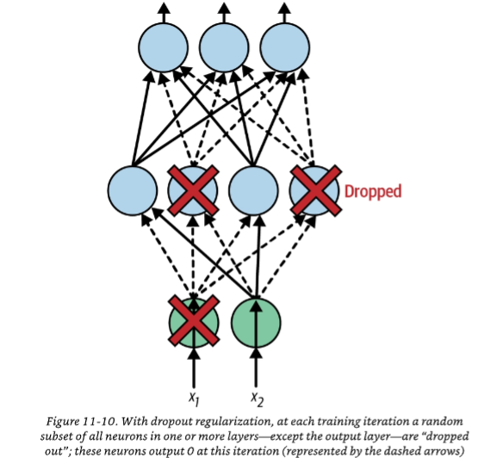
Dropout
Proposed by Hinton in 2012-2014
Highly successful
Concept
Each neuron has a probability of being dropped out (pretend output=0) during any given training step
Probability is typically 10% - 50%
Why does this work? Forces neurons to not “rely” on other neurons as much
Neurons that fire together wire together… or some such thing!

Slide 29
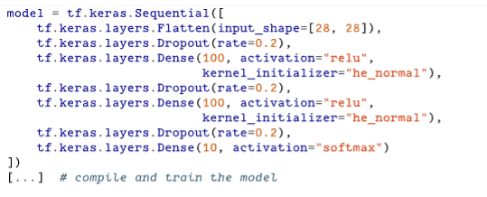
Implementing Dropout?
Again, these ideas are built into our libraries

Slide 30
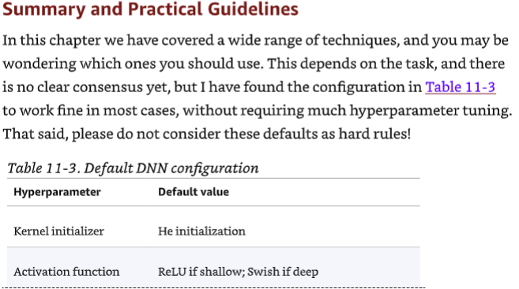
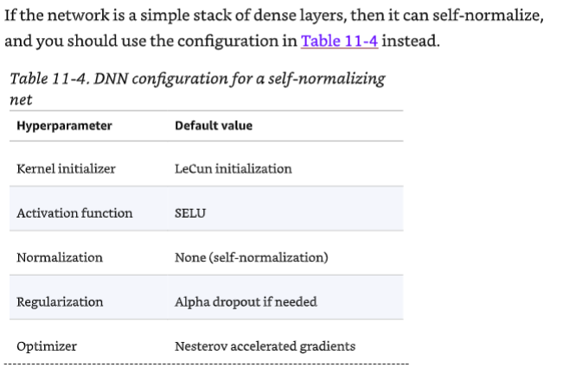
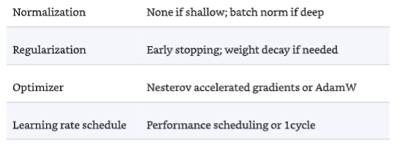
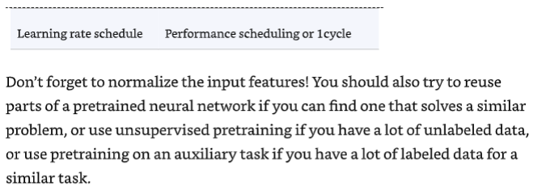
Final Comments from the Author:

Slide 31
BUT… AND…
This is all SO problem-dependent
Know the options and try them
Remember that all these techniques are basically MADE UP
Nothing sacred about any of them
No reason you can’t invent your own
Don’t try zillions of different approaches until the end of time, though!

Slide 32
How About in PyTorch?
What’s Optimization Look Like in PyTorch?
https://pytorch.org/docs/stable/optim.html
And: The COMPLETE PyTorch Zoo- a runthrough
https://pytorch.org/docs/stable/nn.html

